Slide 1



VEHICLE SERVICE CENTRE
MANAGEMENT SYSTEM
Presentation III — User Interface
K. Devika
25WU0102120

Slide 2
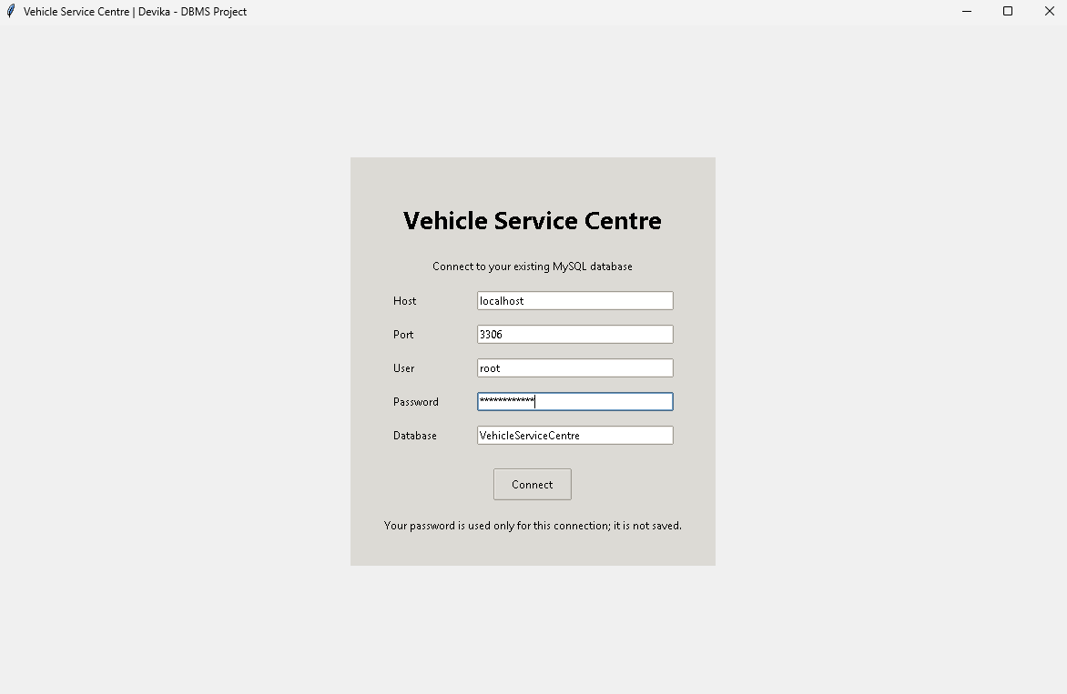
USER INTERFACE
Python Tkinter interface connected to MySQL
View records • Insert records • Delete records

Slide 3
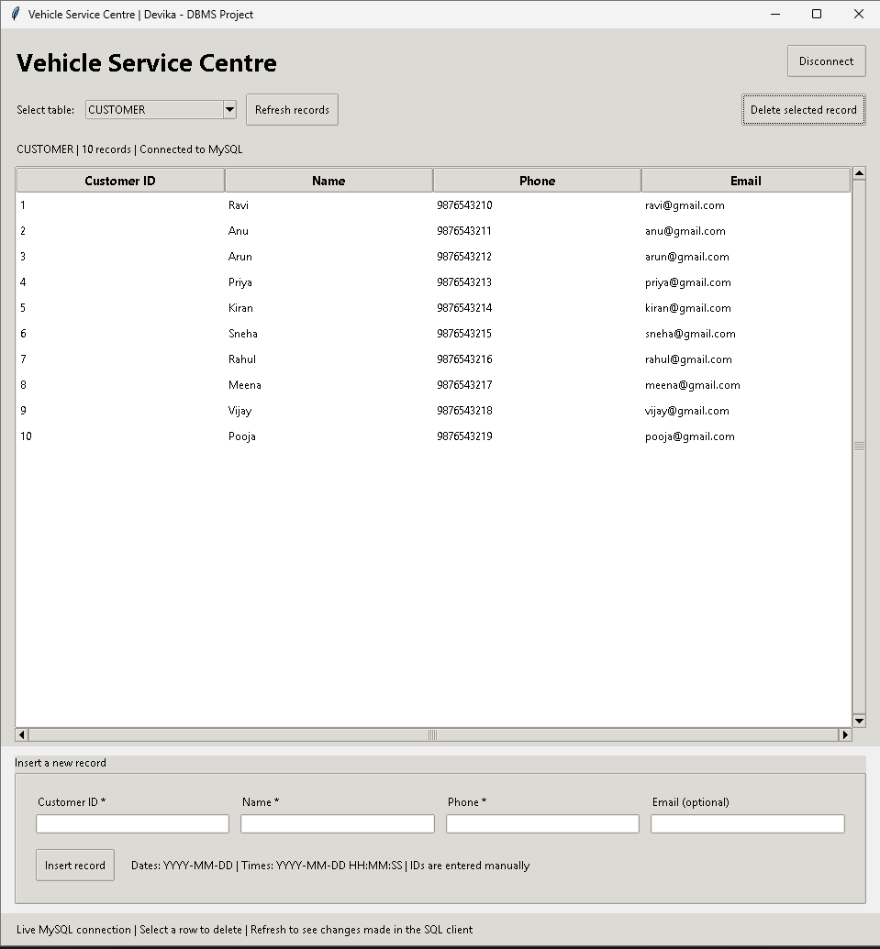
VIEW RECORDS
Select a table to view its records.

Slide 4
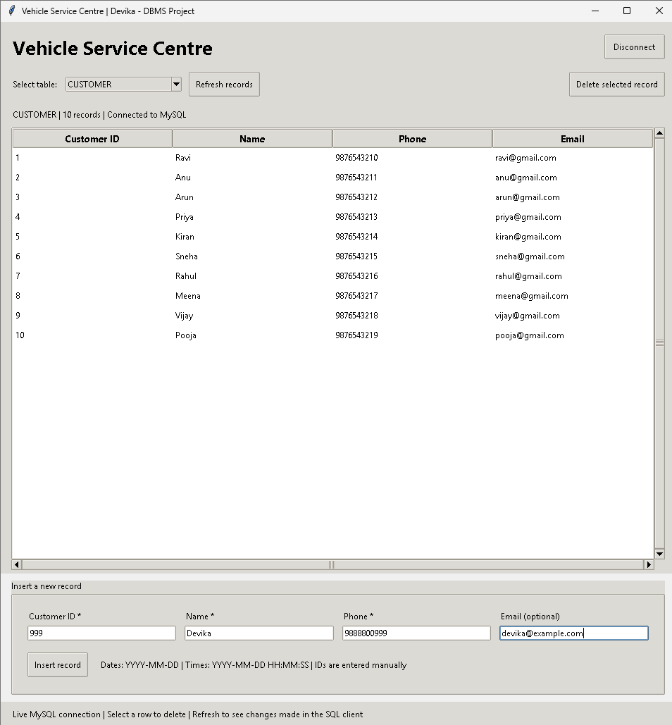
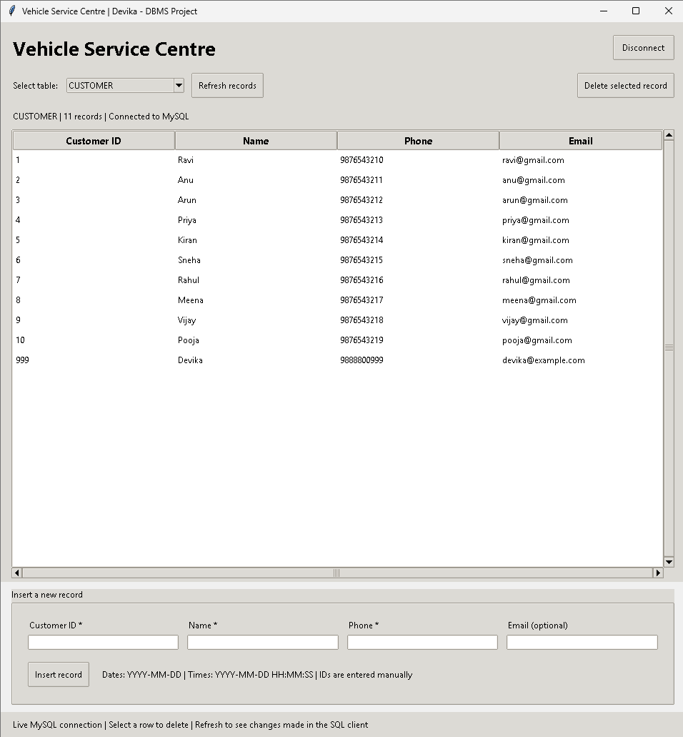
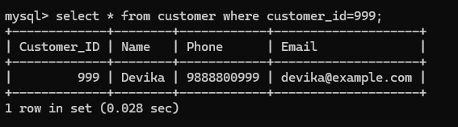
INSERT RECORD
Enter the customer details and click Insert Record.
Before insertion
After insertion
MySQL confirms that customer 999 was saved.

Slide 5
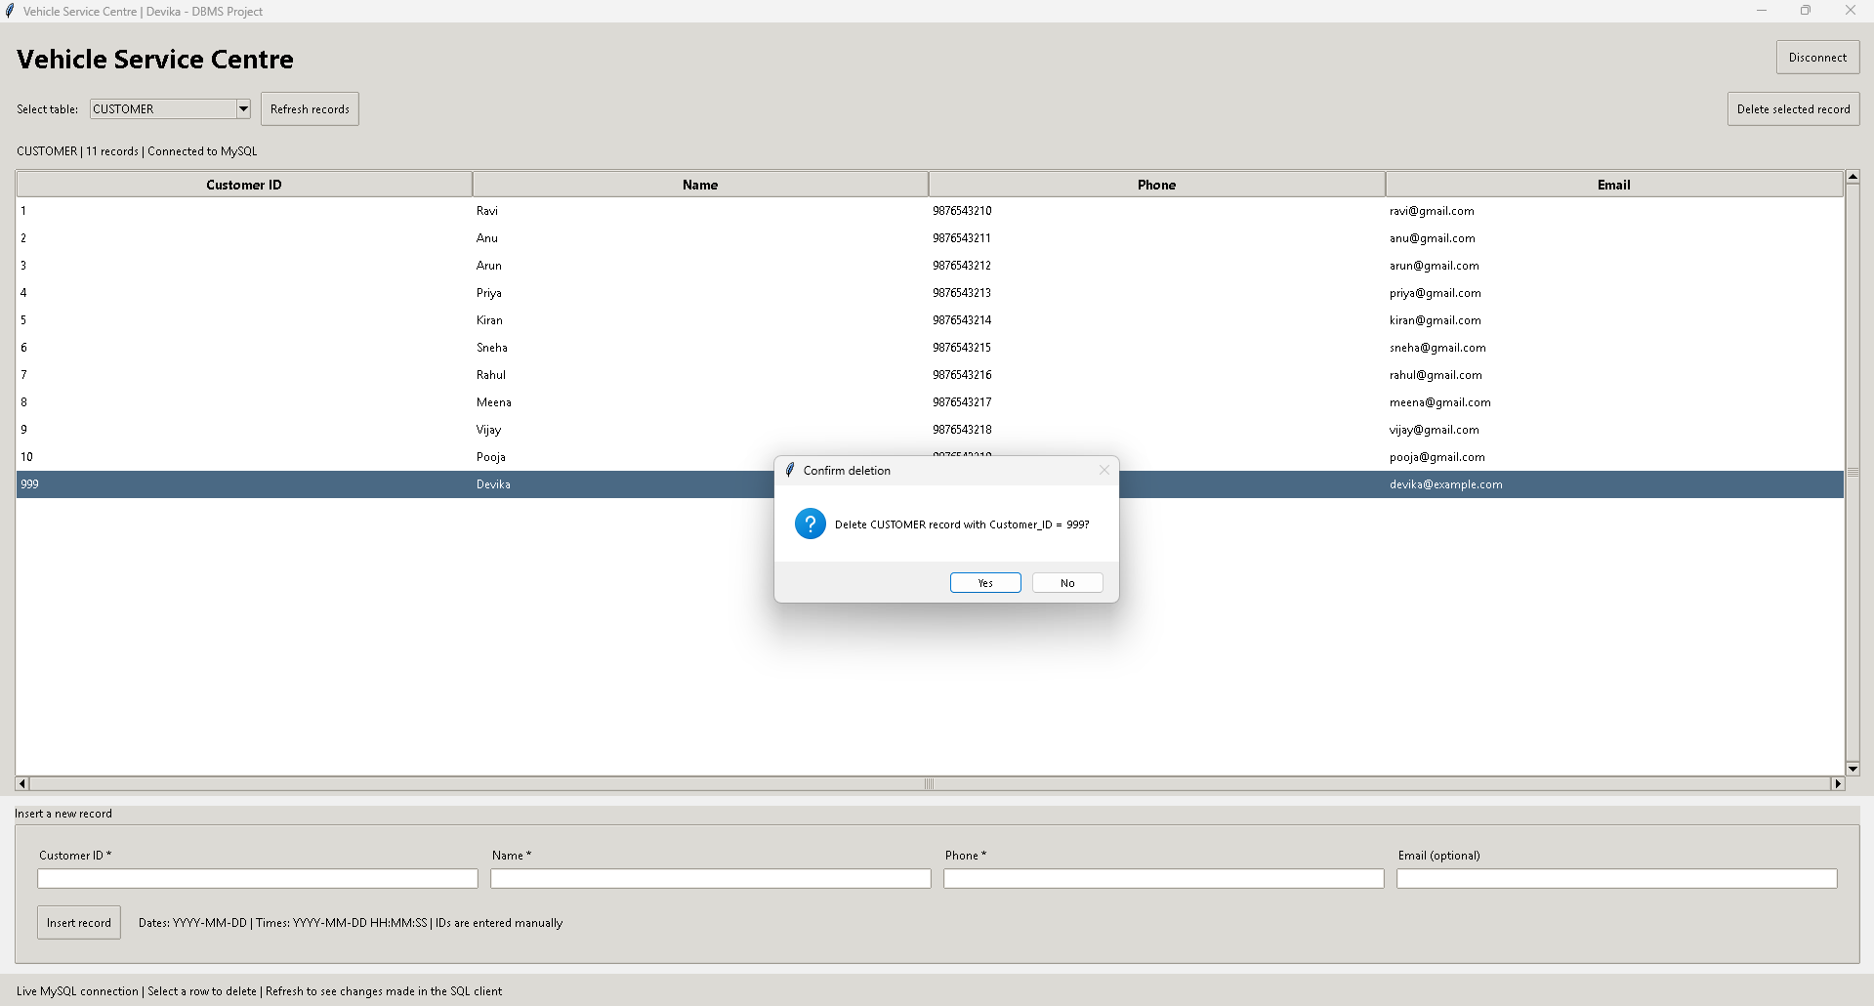
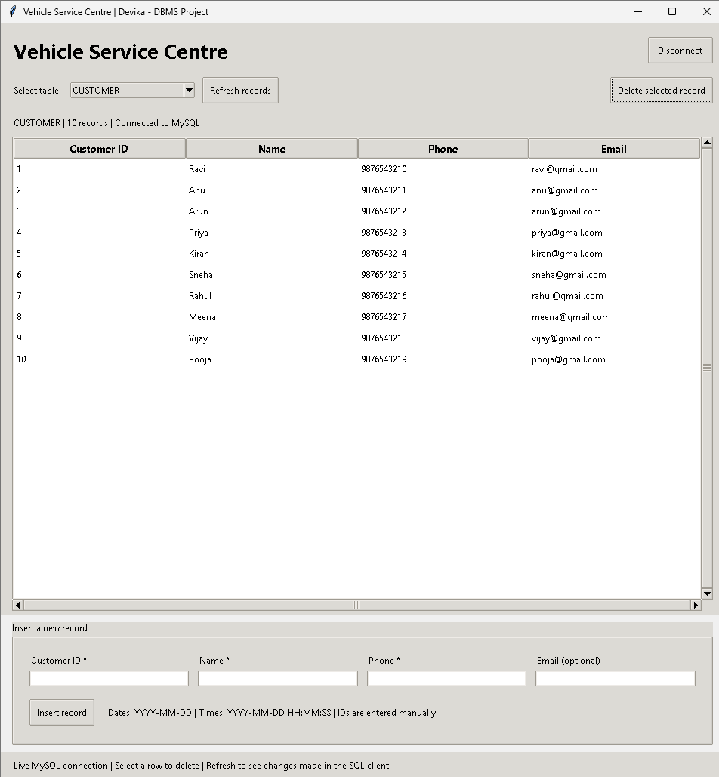

DELETE RECORD
Select the customer, click Delete Selected and confirm.
Delete confirmation
After deletion
MySQL returns “Empty set”: customer 999 was deleted.

